Slide 1
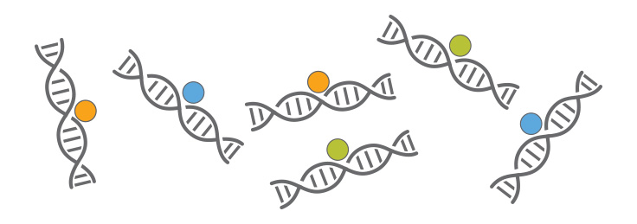
ChIP-seq introduction
Huitian Diao (Yolanda)
References:
ENCODE ChIP-seq pipeline: https://www.encodeproject.org/pipelines/ENCPL138KID/

Slide 2

Using sticky notes for feedback
“I’ve got a good handle on things…”
“I think I understand but I’m still working through things…”
“I’m not understanding and I’m a little lost right now...”

Slide 3
Get course material
Github
Applied-Bioinformatics
Github
HW
git pull
git push
copy
My local:
Applied-Bioinformatics
My local:
My_name_HW

Slide 4
Q&A.1
Why when using some packages we need to include the full path but for others we don't have to?
Step 1. Where are the executables?
%%bash
which grep
which fastqc
/usr/bin/grep
/Users/yolandatiao/anaconda/bin/fastqc
Step 1. How the computer find the executables?
%%bash
printenv | grep “PATH”
PATH=/Users/yolandatiao/anaconda/envs/HDpython3/bin:/Users/yolandatiao/anaconda/envs/HDpython3/bin:/Users/yolandatiao/Documents/0_Bioinformatics2017/201804_Cousera_Unix/Code/newCmd:/Users/yolandatiao/Documents/0_Bioinformatics2017/201804_Cousera_Unix/Code/Commands:/Users/yolandatiao/anaconda/bin:/Users/yolandatiao/anaconda/bin:/Users/yolandatiao/anaconda2/bin:/usr/local/bin:/usr/bin:/bin:/usr/sbin:/sbin:/Users/yolandatiao/.local/bin:/Library/Frameworks/Mono.framework/Versions/Current/Commands

Slide 5
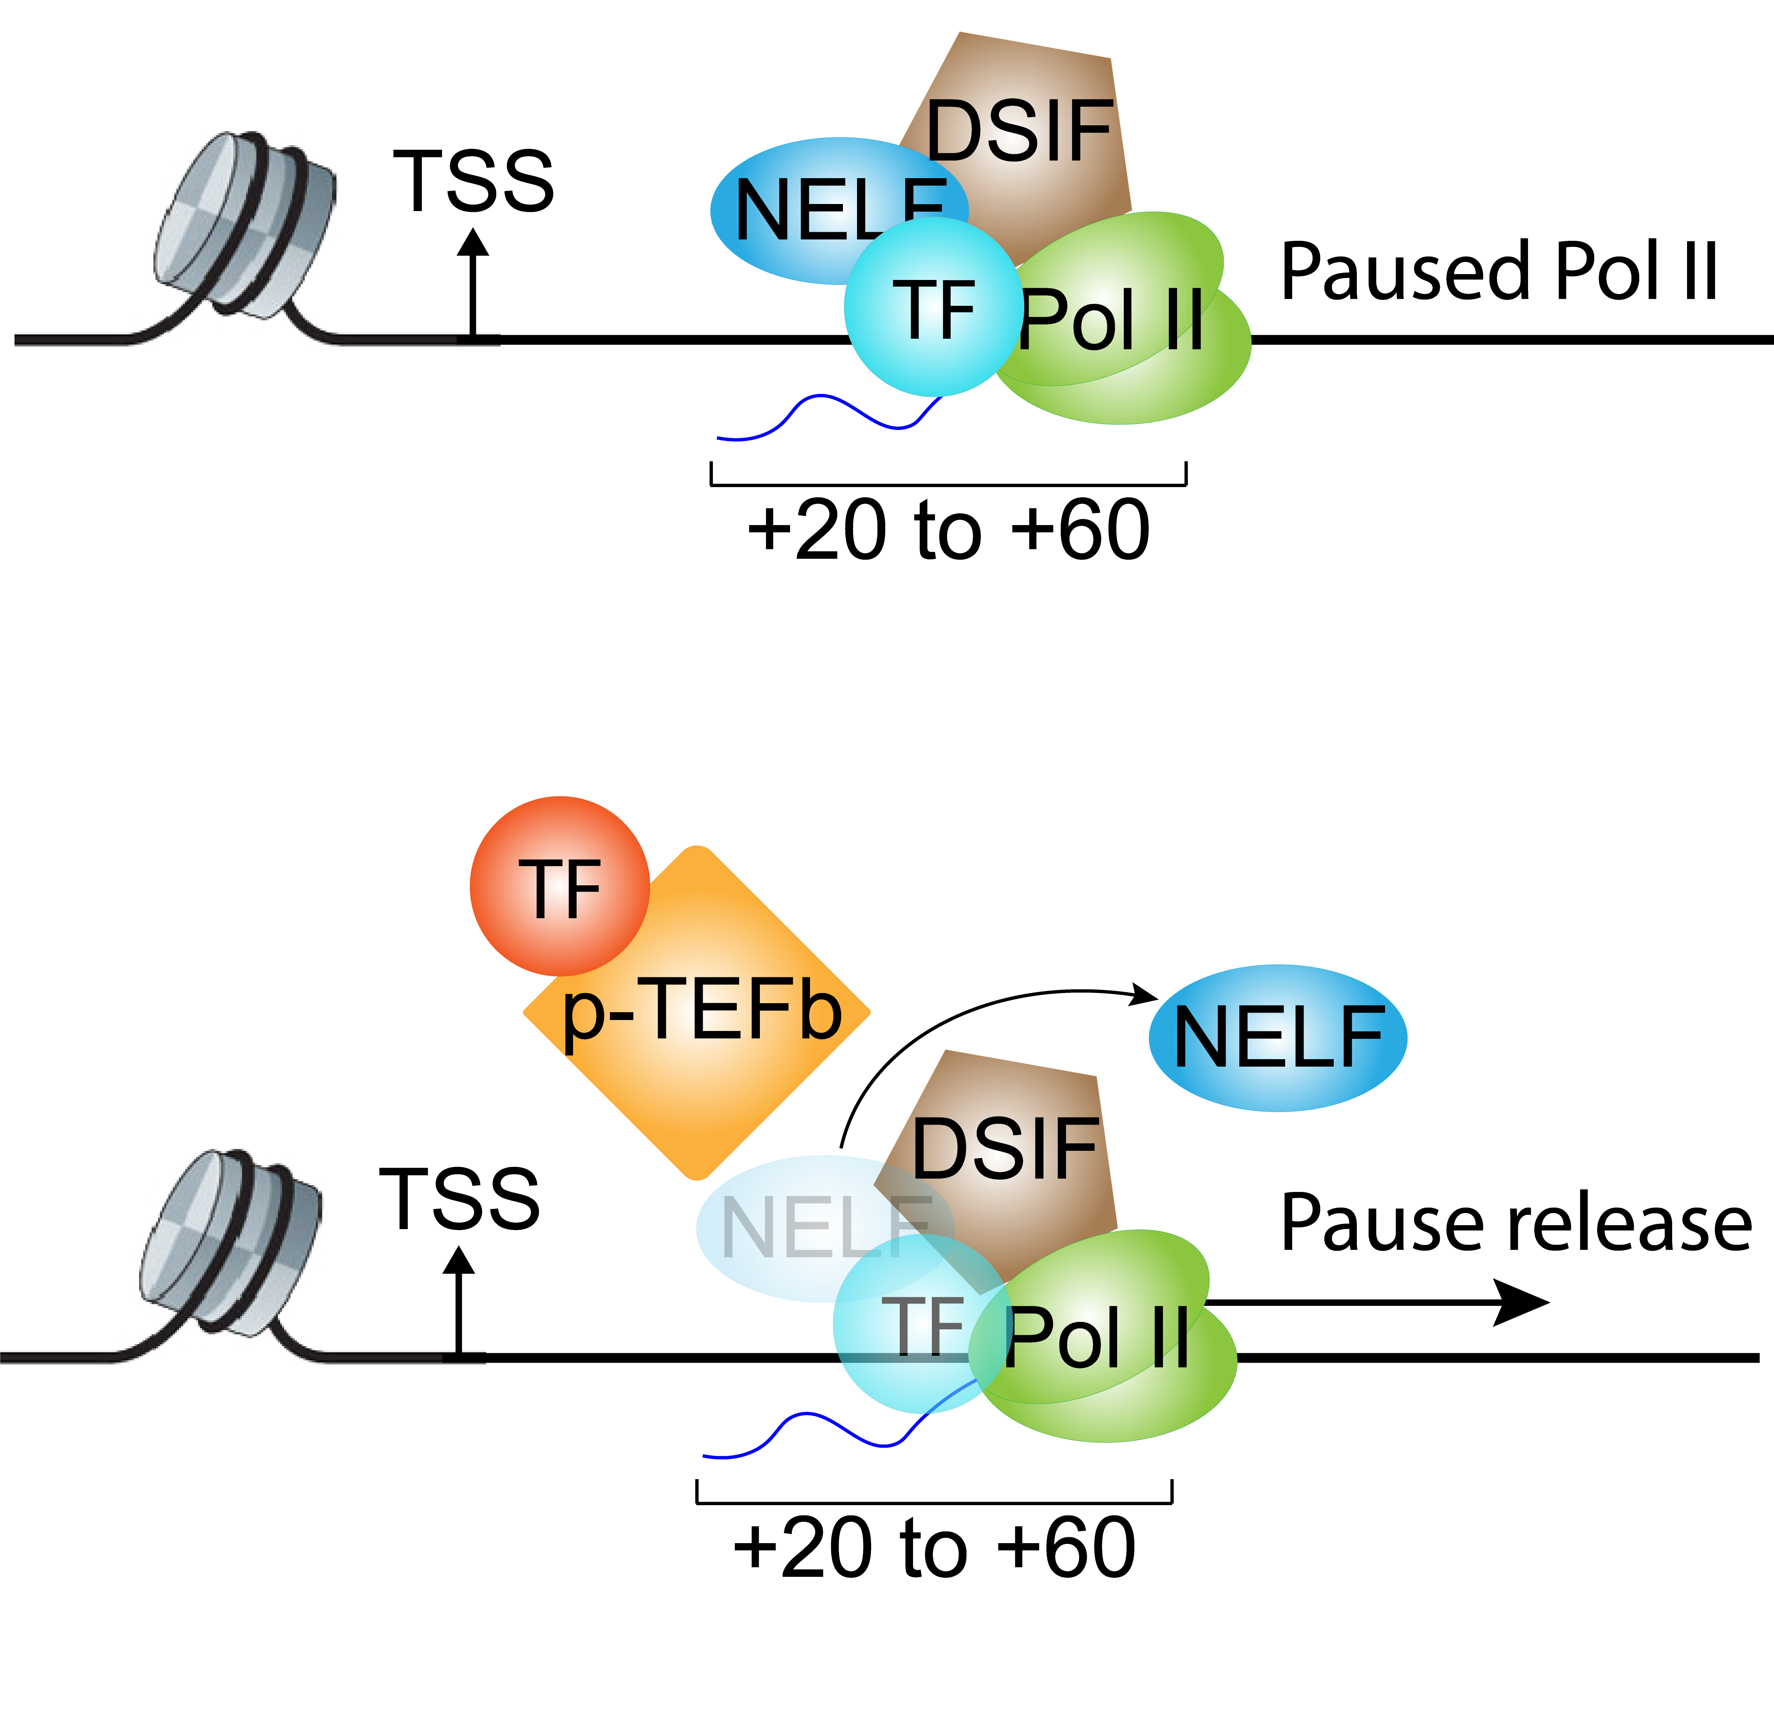
Why ChIP-seq?
DNA in the nucleus is highly condensed
Protein-DNA interaction is crucial
For transcription regulation
ChIP-seq: identify DNA binding sites for proteins
https://www.mun.ca/biology/scarr/Histone_Protein_Structure.html
H. Diao Candidacy Proposal, 2016

Slide 6
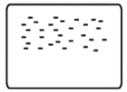
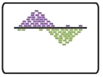

ChIP-seq analysis steps
0
1
2
0.0 | Acquire raw reads | fastq-dump
0.1 | Fastq quality control | fastqc
0.2 | Trimming | TrimGlore
Raw sequenced reads
Raw reads
Alignment
Aligned file
1.0 | Alignment | Bowtie2
1.1 | Convert, sort, filter | Samtools
Aligned to
Genome
Peak Calling
2.0 | Peak calling | MACS2
2.1 | ChIP quality control | ChIPQC
2.2 | Peak visualization | UCSC genome browser
2.3 | Peak annotation | ChIP-seeker
Peak list
Identified Peak
Bardet, Anaïs F., et al. Nature protocols 7.1 (2012): 45.

Slide 7
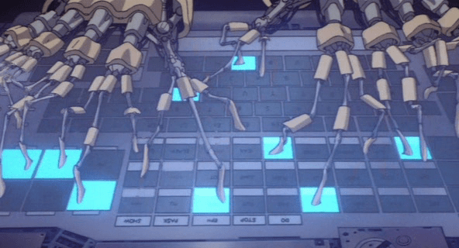
Practice 4.1 (Dump-fastqc)
Tips:
SRA run selector: https://www.ncbi.nlm.nih.gov/Traces/study/?go=home
fastq-dump
fastqc
Objectives:
Find Run numbers for ChIP-seq data from this paper: B. H., Immunity, 2016 1.1 Search for GEO accession number from paper 1.2 Find SubSerie for ChIP-seq data 1.3 Search for ChIP-seq data accession number in SRA Run Selector 1.4 Save RunInfo Table
For the first file in the RunInfoTable: Save the first 50000 spots into a file named test_50000.fastq
Run fastqc for test_50000.fastq Check the quality of the sequcnce

Slide 8
ChIP-seq analysis steps
0
1
2
√
0.0 | Acquire raw reads | fastq-dump
0.1 | Fastq quality control | fastqc
0.2 | Trimming | TrimGlore
Raw sequenced reads
√
Raw reads
Alignment
Aligned file
1.0 | Alignment | Bowtie2
1.1 | Convert, sort, filter | Samtools
Aligned to
Genome
Peak Calling
2.0 | Peak calling | MACS2
2.1 | ChIP quality control | ChIPQC
2.2 | Peak visualization | UCSC genome browser
2.3 | Peak annotation | ChIP-seeker
Peak list
Identified Peak
Bardet, Anaïs F., et al. Nature protocols 7.1 (2012): 45.

Slide 9
Contents
1. Intro to ChIP-seq
1.1 mechanism of ChIP-seq
1.2 ChIP-seq analysis intro
1.3 Fastqc
2. Alignment and Quality control
2.1 Trim_galore
2.2 Alignment and filter
3. Peak calling
3.1 Intro to peak calling algorithm
3.2 MACS2 peak calling
3.3 ChIP-QC
4. Data visualization
4.1 Data preparation for visualization
4.2 UCSC genome browser
5. Peak annotation and pathway analysis
5.1 Differential analysis with DiffBind
5.2 Peak annotation with ChIPseeker
6. Downstream analysis
6.3 Pathway analysis with ClusterProfiler

Slide 10
Practice 4.2 (Dump-multiqc)
Tips: Q2.2: Self-help
Google: generate array of number in shell
Google: shell seq output scientific notation
Google: shell convert stdout to array
Q3: Self-help
Google: multiqc documentation
Questions:
Find Run numbers for ChIP-seq data from this paper: B. H., Immunity, 2016 1.1 Search for GEO accession number from paper 1.2 Find SubSerie for ChIP-seq data 1.3 Search for ChIP-seq data accession number in SRA Run Selector 1.4 Save RunInfo Table
Build a folder named Sample_fastq 2.1 Redirect to the new folder 2.2 Save the first 500 spots of each file into SRRXXXXX.500.fastq with a for loop 2.3 Run fastqc on all the files
Run multiqc on the fastqc outputs Read fastqc and multiqc outputs. What did you find?

Slide 11
Why trim Adapter -- Adapter contamination leads to lower alignment rate
Adapters are ligated to DNA molecules during library preparation
In Illumina sequencing, 3’ end adapter would be sequenced
if DNA insert is shorter than number of sequencing cycles

Slide 12
Alignment: ChIP-seq v.s. RNA-seq
Genome sequencing
ChIP-seq
ATAC-seq
Hi-C …
Transcriptome sequencing
RNA-seq
https://www.khanacademy.org/science/biology/gene-expression-central-dogma

Slide 13
File formats – fastq, sam
Fastq File
Sequence identifier
Sequence
Quality score identifier (+)
Quality score
@SIM:1:FCX:1:15:6329:1045 1:N:0:2
TCGCACTCAACGCCCTGCATATGACAAGACAGAATC
+
<>;##=><9=AAAAAAAAAA9#:<#<;<<<????#=
Sam File
@HD VN:1.3 SO:coordinate @SQ SN:conticA LN:443 @SQ SN:contigB LN:1493 @SQ SN:contigC LN:328
Header
readID43GYAX15:7:1:1202:19894/1 256 contig43 613960 1 65M * 0 0 CCAGCGCGAACGAAATCCGCATGCGTCTGGTCGTTGCACGGAACGGCGGCGGTGTGATGCACGGC EDDEEDEE=EE?DE??DDDBADEBEFFFDBEFFEBCBC=?BEEEE@=:?::?7?:8-6?7?@??# AS:i:0 XS:i:0 XN:i:0 XM:i:0 XO:i:0 XG:i:0 NM:i:0 MD:Z:65 YT:Z:UU
Alignment info
Name | Sam Flag | Ref Name | Position | MAPQ quality | CIGAR string | Mate name | Mate Pos | Temp length | Read Sequence | Read Quality | Add. Info
* Columns separated by Tab (/t)
All you want to know about file formats is here: https://genome.ucsc.edu/FAQ/FAQformat.html

